Slide 1
Unix Operating System
By: Rizaller Amolo

Slide 2
Origin
The pre-history of Unix dates back to the mid-1960s when the Massachusetts Institute of Technology, Bell Labs, and General Electric were developing an innovative time-sharing operating system called Multics for the GE-645 mainframe. Multics introduced many innovations, but had many problems.
Their last researchers to leave Multics, Ken Thompson, Dennis Ritchie, M. D. McIlroy, and J. F. Ossanna, decided to redo the work on a much smaller scale.

Slide 3
Origin (cont.)
The name Unics (Uniplexed Information and Computing Service, pronounced as "eunuchs"), a pun on Multics (Multiplexed Information and Computer Services), was initially suggested for the project in 1970: the new operating system was an emasculated Multics.
Brian Kernighan claims the coining for himself, and adds that "no one can remember" who came up with the final spelling Unix.

Slide 4
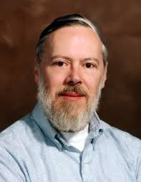
Developers - Dennis Ritchie
He created the C programming language and, with long-time colleague Ken Thompson, the Unix operating system.

Slide 5
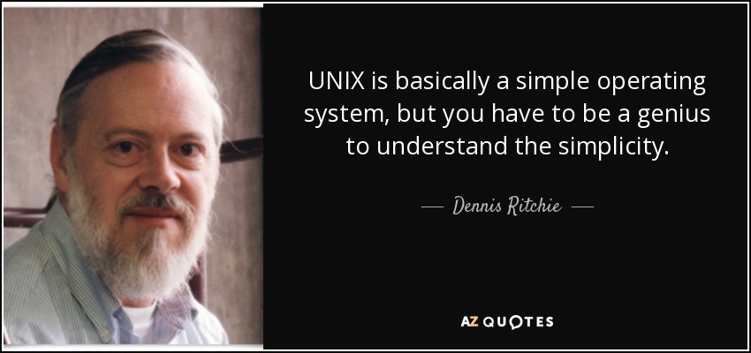
Developers – Dennis Ritchie

Slide 6
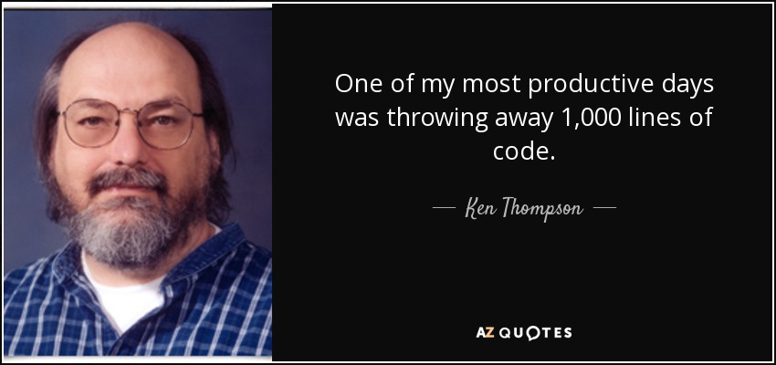
Developers – Ken Thompson
Having worked at Bell Labs for most of his career, Thompson designed and implemented the original Unix operating system. He also invented the B programming language, the direct predecessor to the C programming language.

Slide 7
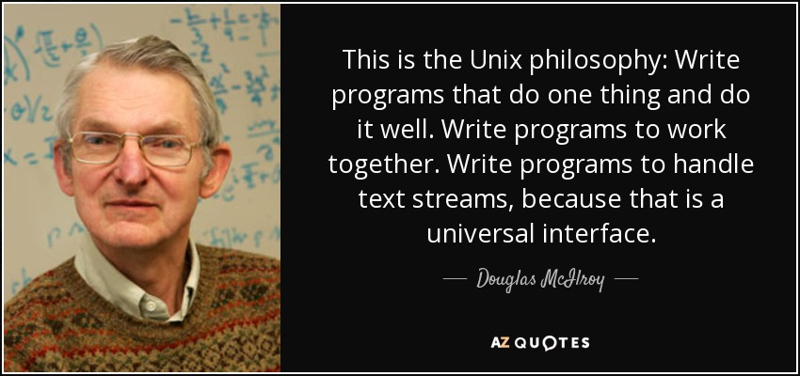
Developers – Ken Thompson
Unix Philosophy – is a set of cultural norms and philosophical approaches to minimalist, modular software development. It emphasizes building simple, short, clear, modular, and extensible code that can be easily maintained and repurposed by developers other than its creators.

Slide 8
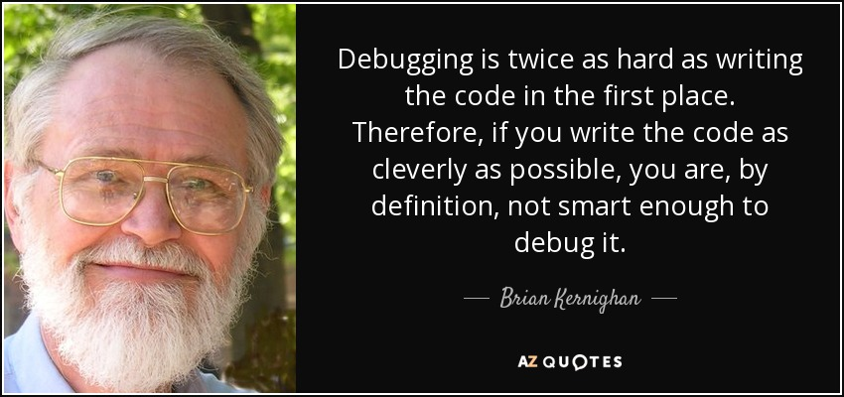
Developers
Brian Wilson Kernighan
M. D. Mcllroy
Joe Ossanna

Slide 9
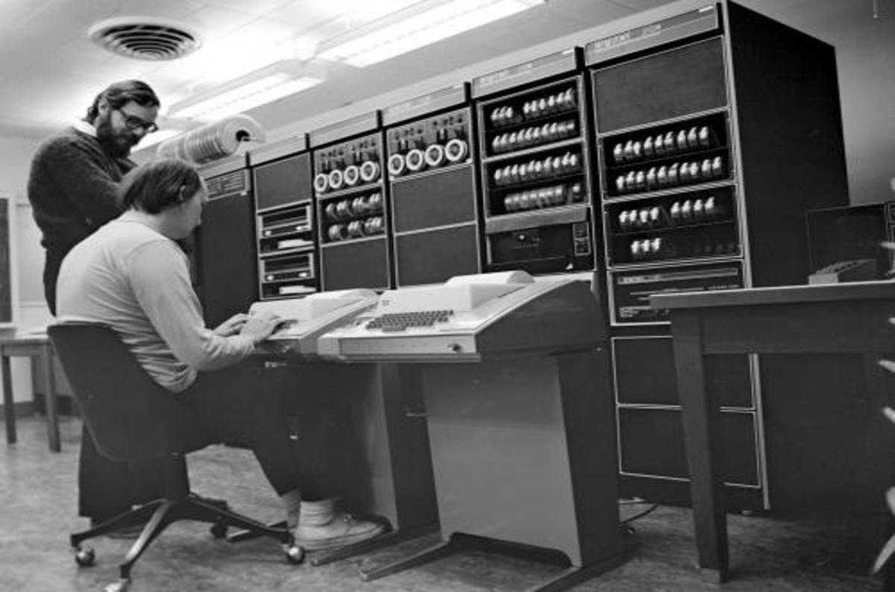
Versions - 1st Edition
Released Nov. 3, 1971.
based on the version that ran on the PDP-11 at the time. Includes the Thompson shell, mail, cp, and su. The operating system was two years old, having been ported from the PDP-7 to the PDP-11/20 in 1970.

Slide 10
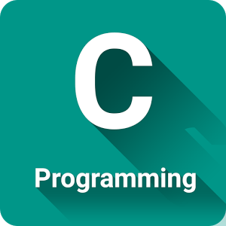
2nd and 3rd Edition
Feb. 1973
Total number of installations at the time was 10 - 16.
Introduced C.
Commands are split between /bin and /usr/bin, requiring a search path.

Slide 11
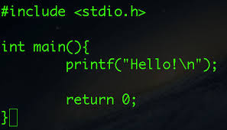
4th Edition
Nov. 1973
First version written in C. Also introduced groups, grep, and printf.
The first public exposition of the operating system.
Number of installations was listed as "above 20"

Slide 12
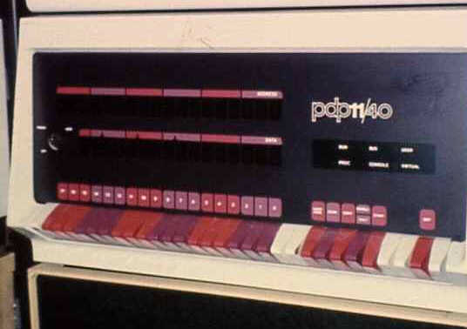
5th Edition
Jun. 1974
Widely licensed to educational institutions.
Introduced find, dd, and the sticky bit.
Targeted the PDP-11/40 and other 11 models with 18 bit addresses.
Installations "above 50".

Slide 13
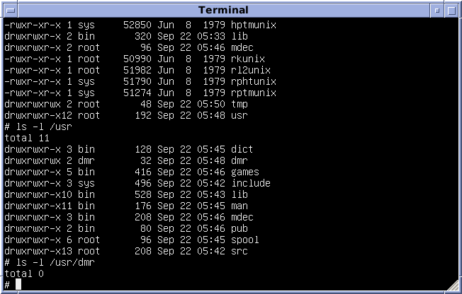
6th Edition
May 1975
First version to be also licensed to commercial users, and to be ported to non-PDP hardware.
Includes ratfor and bc.

Slide 14
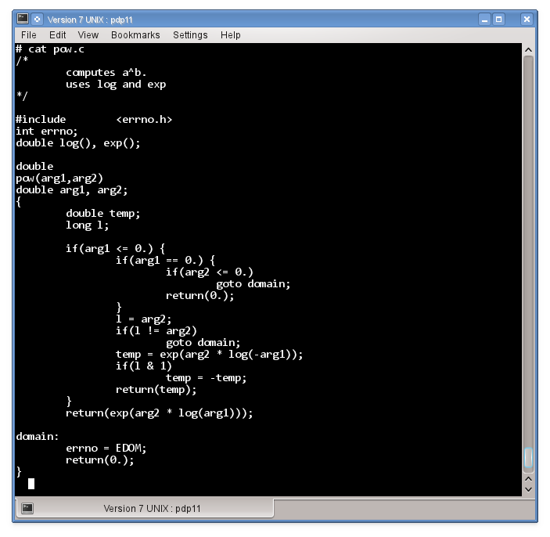
7th Edition
Jan. 1979
Includes the Bourne shell, cpio, sed, ioctl, awk, f77, spell, stdio and pcc replacing the Dennis Ritchie's C compiler.
The ancestor of all modern UNIX systems and the last release of Research Unix to see widespread external distributions. Merged most of the utilities of PWB/UNIX with an extensively modified kernel with almost 80% more lines of code than V6.

Slide 15
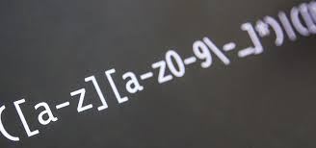
8th Edition
Feb. 1985
Used internally, and only licensed for educational use.
The Blit graphics terminal became the primary user interface.
Added a network filesystem that allowed accessing remote computers' files as /n/hostname/path, and a regular expression library that introduced an API later mimicked by Henry Spencer's reimplementation.

Slide 16
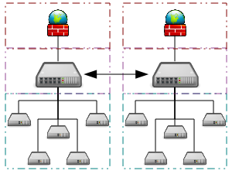
9th Edition
Sep. 1986
Featured a generalized version of the Streams IPC mechanism introduced in V8.
The mount system call was extended to connect a stream to a file, the other end of which could be connected to a (user-level) program. This mechanism was used to implement network connection code in userspace.

Slide 17
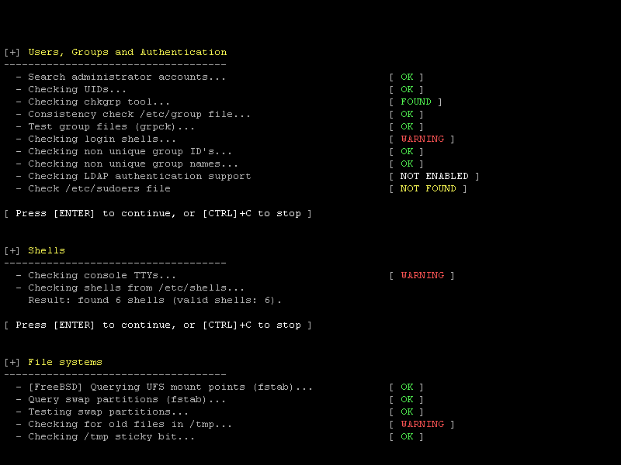
Sample Screenshots

Slide 18
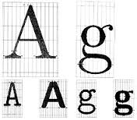
10th Edition
Oct. 1989
Last Research Unix.
According to Dennis Ritchie, V9 and V10 were "conceptual": manuals existed, but no OS distributions "in complete and coherent form".
Novelties included graphics typesetting tools designed to work with troff, a C interpreter, animation programs, and several tools later found in Plan 9: the Mk build tool and the rc shell.

Slide 19
Sample Screenshots (cont.)

Slide 20
Sample Screenshots (cont.)

